Slide 1

AASD 4004
Machine Learning - II
Applied AI Solutions Developer Program

Slide 2
Module 16 Audio Use Cases
Vejey Gandyer

Slide 3
Agenda
Audio Classification
Unsupervised Audio Segmentation
Speaker Diarization
Speech to Text
Text to Speech

Slide 4
Audio Classification

Slide 5
Audio Classification
Classify audio clips into different musical genres
WAV files are organized in two folders representing two genres
Audio features to be extracted, and a classifier model to be built on these features

Slide 6
Audio Classification
Steps
Load the WAV files from folders into Numpy arrays
Extract segment-level feature statistics from them
Choose any classifier algorithm (SVM)
Train a SVM model
Apply the model on the data
Plot the predictions (decision boundary to split two genres)

Slide 7
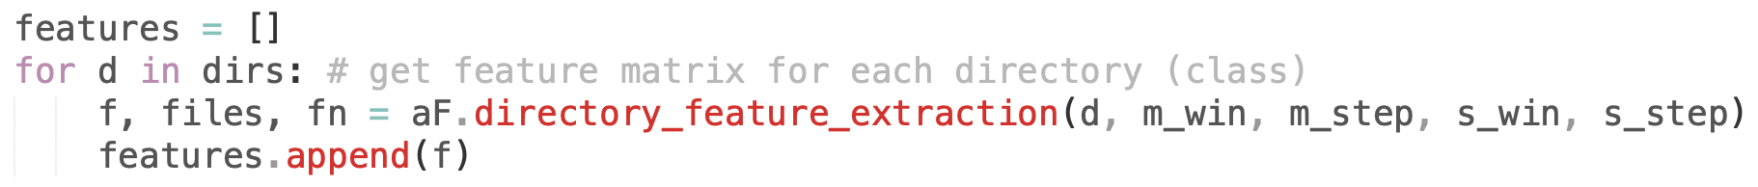
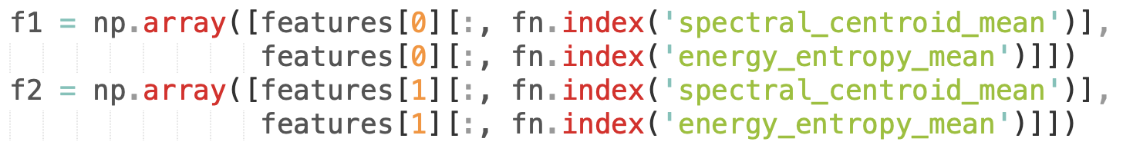
Audio Classification
Load the WAV files from folders into Numpy arrays
Extract segment-level feature statistics from them​

Slide 8
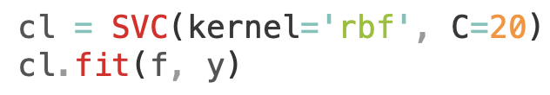
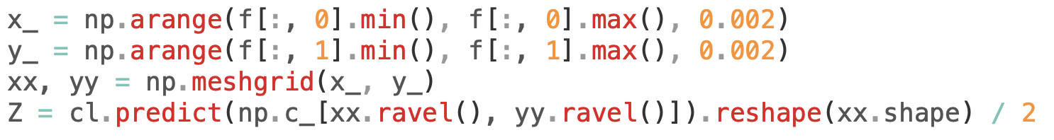
Audio Classification
Train a SVM model
Apply the model on the data

Slide 9
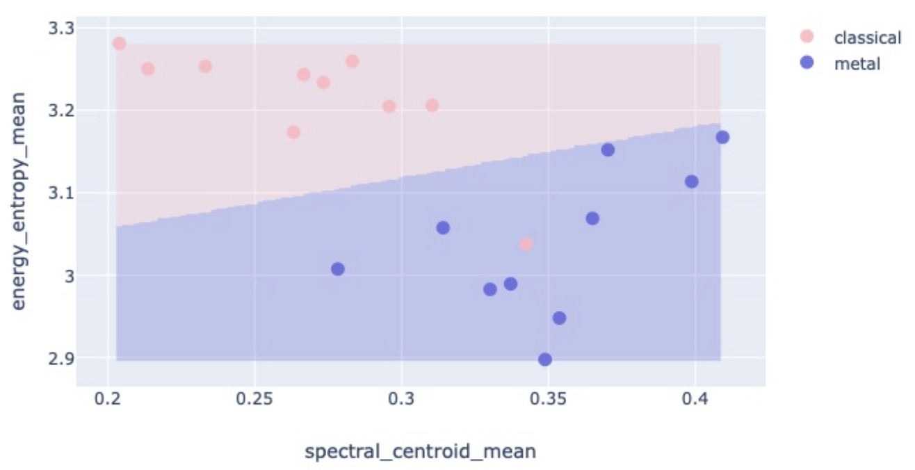
Audio Classification
Plot the predictions (decision boundary to split two genres)

Slide 10
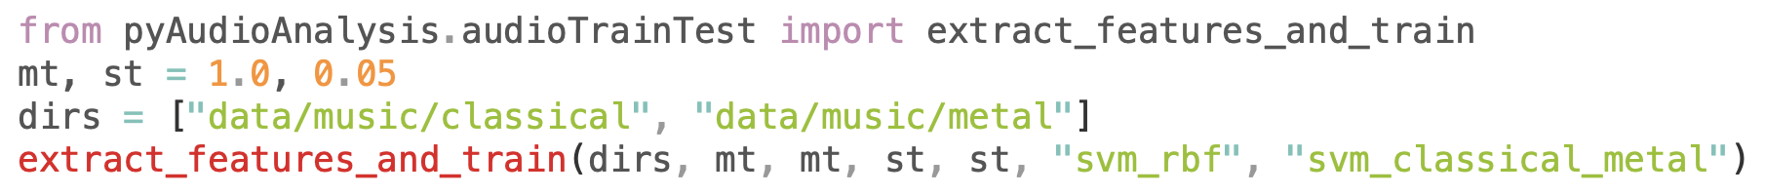
Audio Classification
PyAudioAnalysis Wrapper - Feature Extraction + Classifier

Slide 11
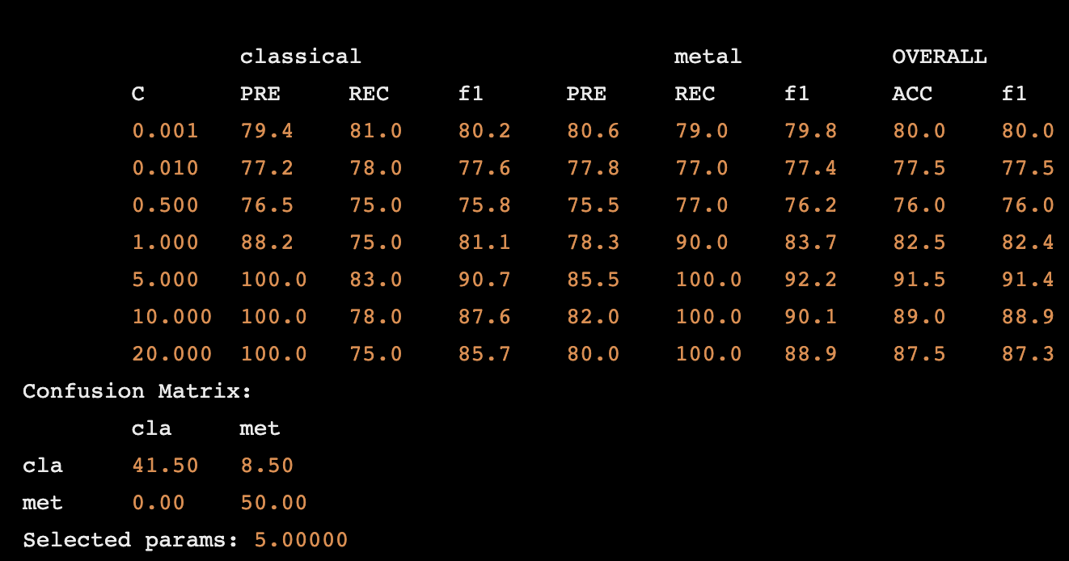
Audio Classification
Best Classifier with C = 5

Slide 12
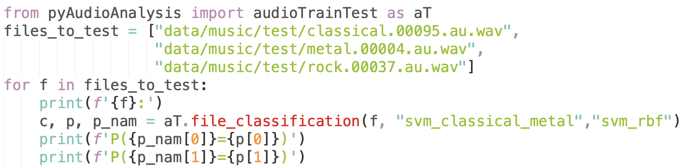
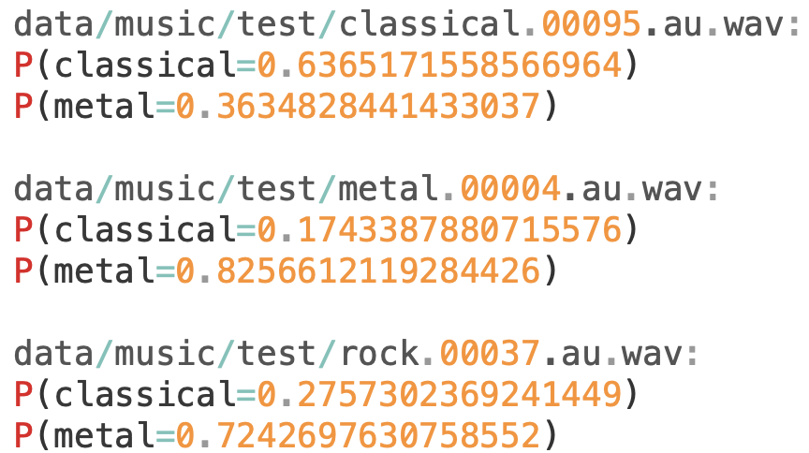
Audio Classification
Predictions on Unseen testing data

Slide 13
Audio Segmentation

Slide 14
Audio Segmentation
Assumption: Unknown audio clips always belong to a single label
Real-world recordings are not segments of homogeneous content but sequences of segments of different labels
Audio Segmentation is about segmenting a long audio recording to a sequence of segments that are of homogenous content
Supervised segmentation
Unsupervised segmentation

Slide 15
Audio Segmentation
Supervised

Slide 16
Supervised Audio Segmentation
Based on a pretrained segment model that can classify homogenous segments
Pretrained segment model is needed

Slide 17
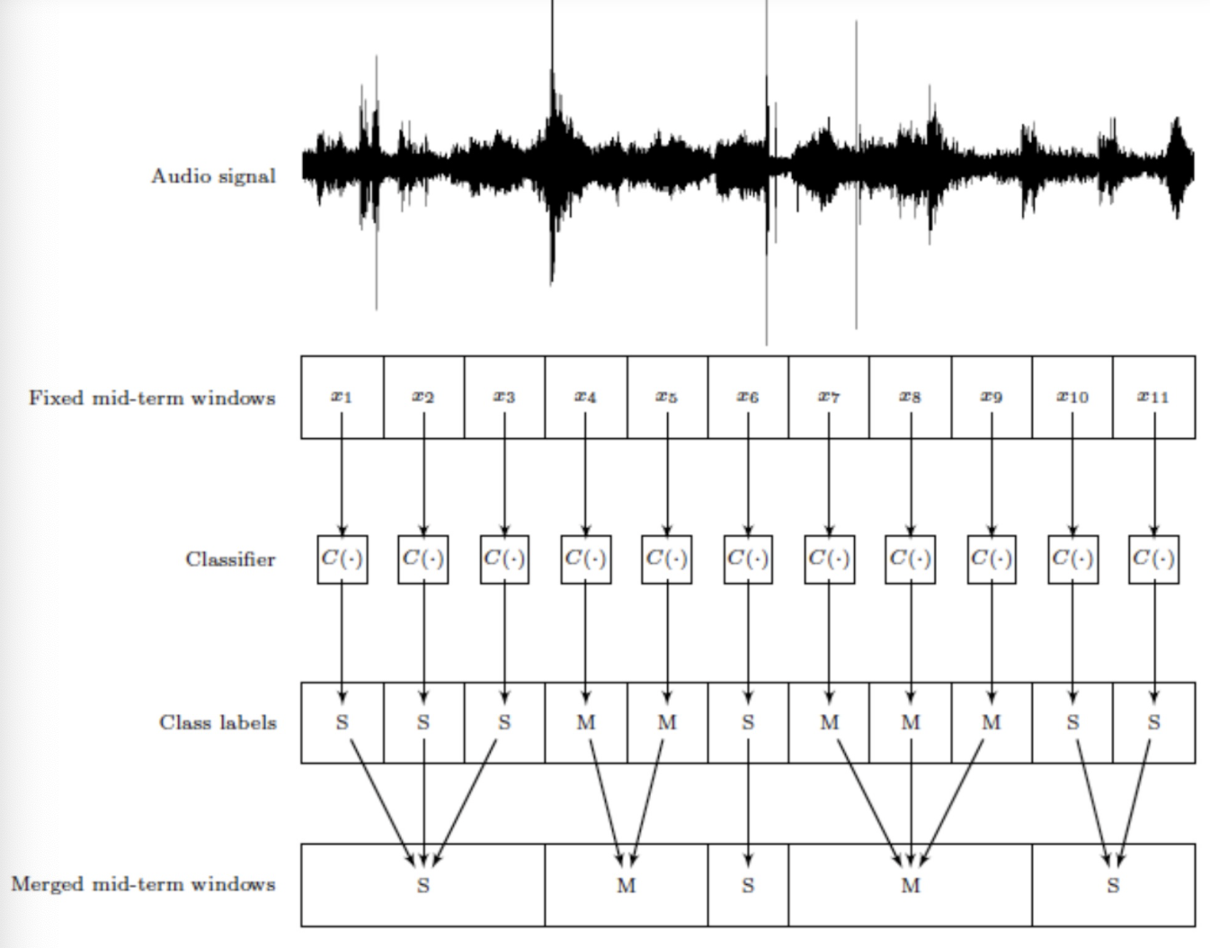
Supervised Audio Segmentation
Steps​
Split audio clips into non-overlapping fix-sized segments​
Classify each fix-sized segment using trained model​
Merge successive segments that contain same class label​

Slide 18
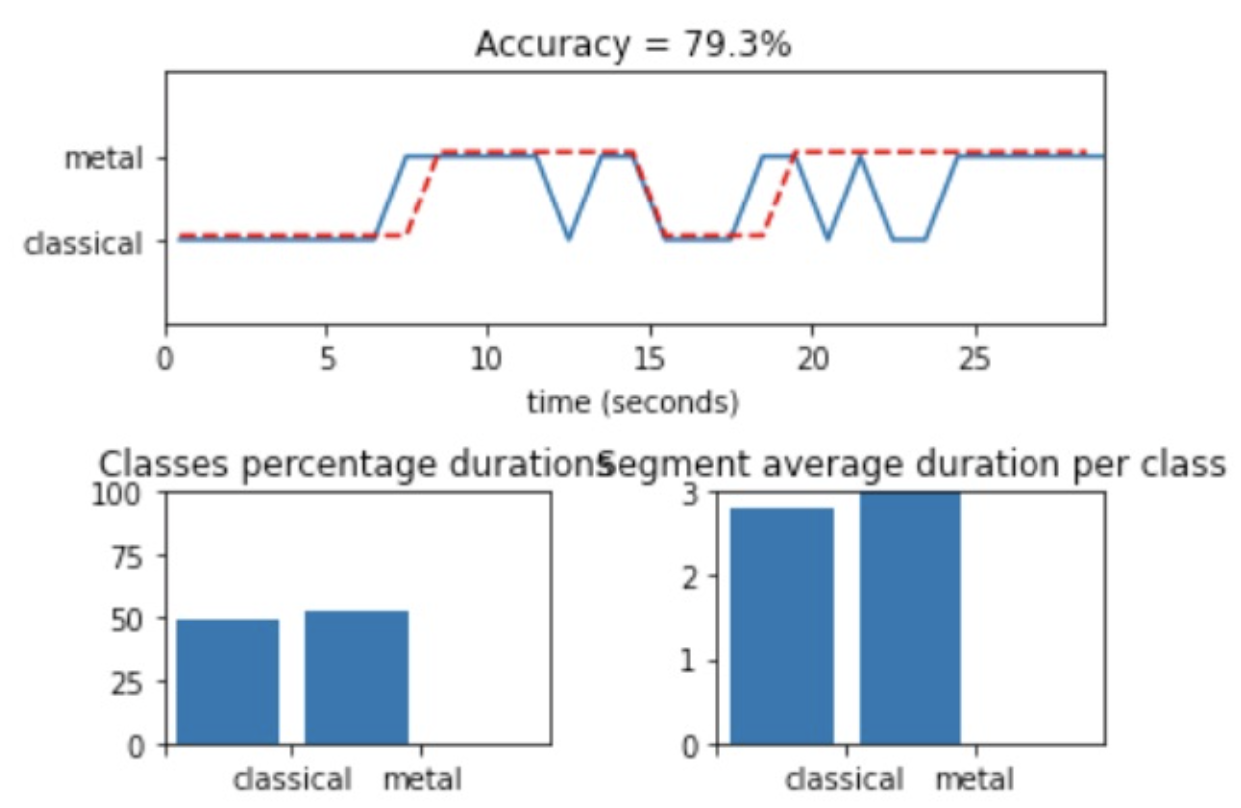
Supervised Audio Segmentation

Slide 19
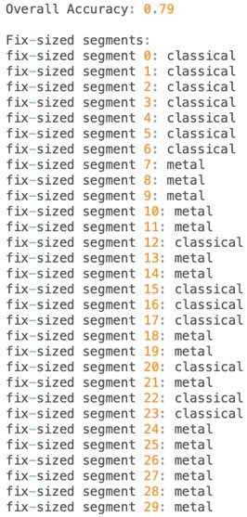
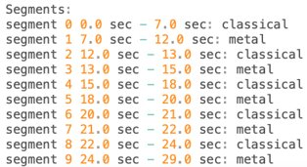
Supervised Audio Segmentation
Errors are mainly due to:
Misclassifications of segment classifier
Time resolution issues

Slide 20
Audio Segmentation
Unsupervised

Slide 21
Unsupervised Audio Segmentation
Pretrained segment model is needed for supervised approach
In real-world, no data to train such a pretrained segment model is possible
Can you group song segments so that segments of the same group sound like they belong to the same song part?

Slide 22
Unsupervised Audio Segmentation
Grouping data points --> K-Means Clustering
Clusters of song segments may correspond to stuctural song elements if appropriate audio features are used

Slide 23

Unsupervised Audio Segmentation
Cluster 1
Cluster 2
Cluster 3
Cluster 4

Slide 24
Speaker Diarization
Who speaks when?

Slide 25
Speaker Diarization
Given a long audio sample with different speakers, group audio segments from a same speaker
Almost Unsupervised Audio Segmentation problem

Slide 26
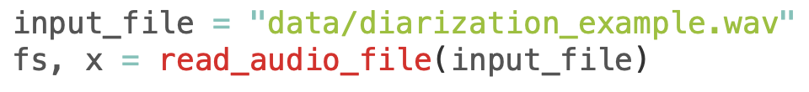
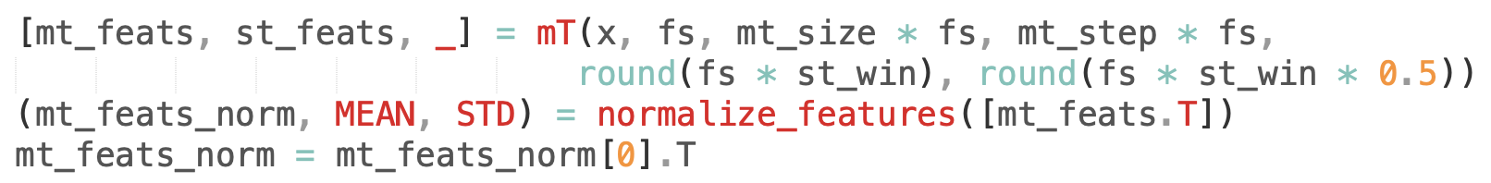
Speaker Diarization
Read the long audio file
Extract features

Slide 27
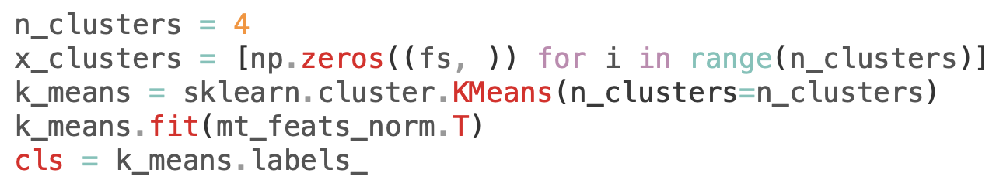
Speaker Diarization
Create clusters on the extracted features

Slide 28
Speaker Diarization
Original Example
Hillary Clinton
Kamalla Harris
Donald Trump
Barrack Obama

Slide 29
Speech To Text (Speech Recognition)

Slide 30
Speech-To-Text (Speech Recognition)
Speech Recognition is a system that translates the language being spoken into digitized text format
Features
Streaming speech to text in real-time: the API is capable of processing real-time audio signals from the device microphone or take an audio file as input and convert it into text also.
Different models based on the domain: you can choose from different trained models depending on the requirements of the project. For example, for converting audio from a telephone, the enhanced phone call model can be used.
Adaptation: you can customize the API to understand rare words, currency, numbers etc by making these as additional classes.

Slide 31
Speech-To-Text (Speech Recognition)
Install the necessary library
Import the library
Create the Speech-To-Text Recognizer object

Slide 32
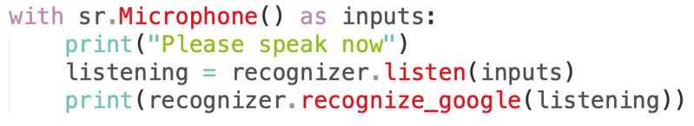
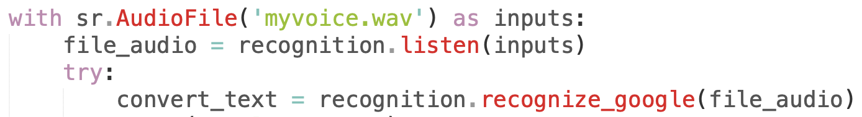
Speech-To-Text (Speech Recognition)
Listen to the microphone and convert speech to text
Listen to the audio file and convert speech to text

Slide 33
Text to Speech

Slide 34
Text to Speech
Google Text to Speech gTTS API
Features
Customizable speech-specific sentence tokenizer that allows for unlimited lengths of text to be read, all while keeping proper intonation, abbreviations, decimals
Customizable text pre-processors which can, for example, provide pronunciation corrections
Automatic retrieval of supported languages

Slide 35


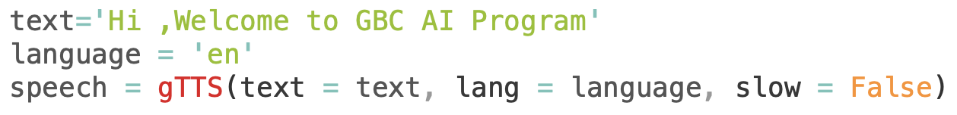
Text-To-Speech
Install the necessary library
Import the library
Create the Text-To-Speech Recognizer object
Import the library

Slide 36
Further Reading
PyAudioAnalysis
https://github.com/tyiannak/pyAudioAnalysis
Feature Extraction
https://github.com/tyiannak/pyAudioAnalysis/wiki/3.-Feature-Extraction
https://github.com/tyiannak/basic_audio_analysis/blob/master/notebobok.ipynb
https://hackernoon.com/intro-to-audio-analysis-recognizing-sounds-using-machine-learning-qy2r3ufl

Slide 37
Further Reading
PyPDF2
https://pypi.org/project/PyPDF2/
Pyttsx3
https://pyttsx3.readthedocs.io/en/latest/

